Slide 1
TAmob

Slide 2
/Volumes/Model_Center/Tel-aviv/NewVideos2025/Export 05-05-2025 09-30-00/Media player format/AXIS P5655-E PTZ Dome Network Camera (10.197.21.23) - Camera 1

Slide 3
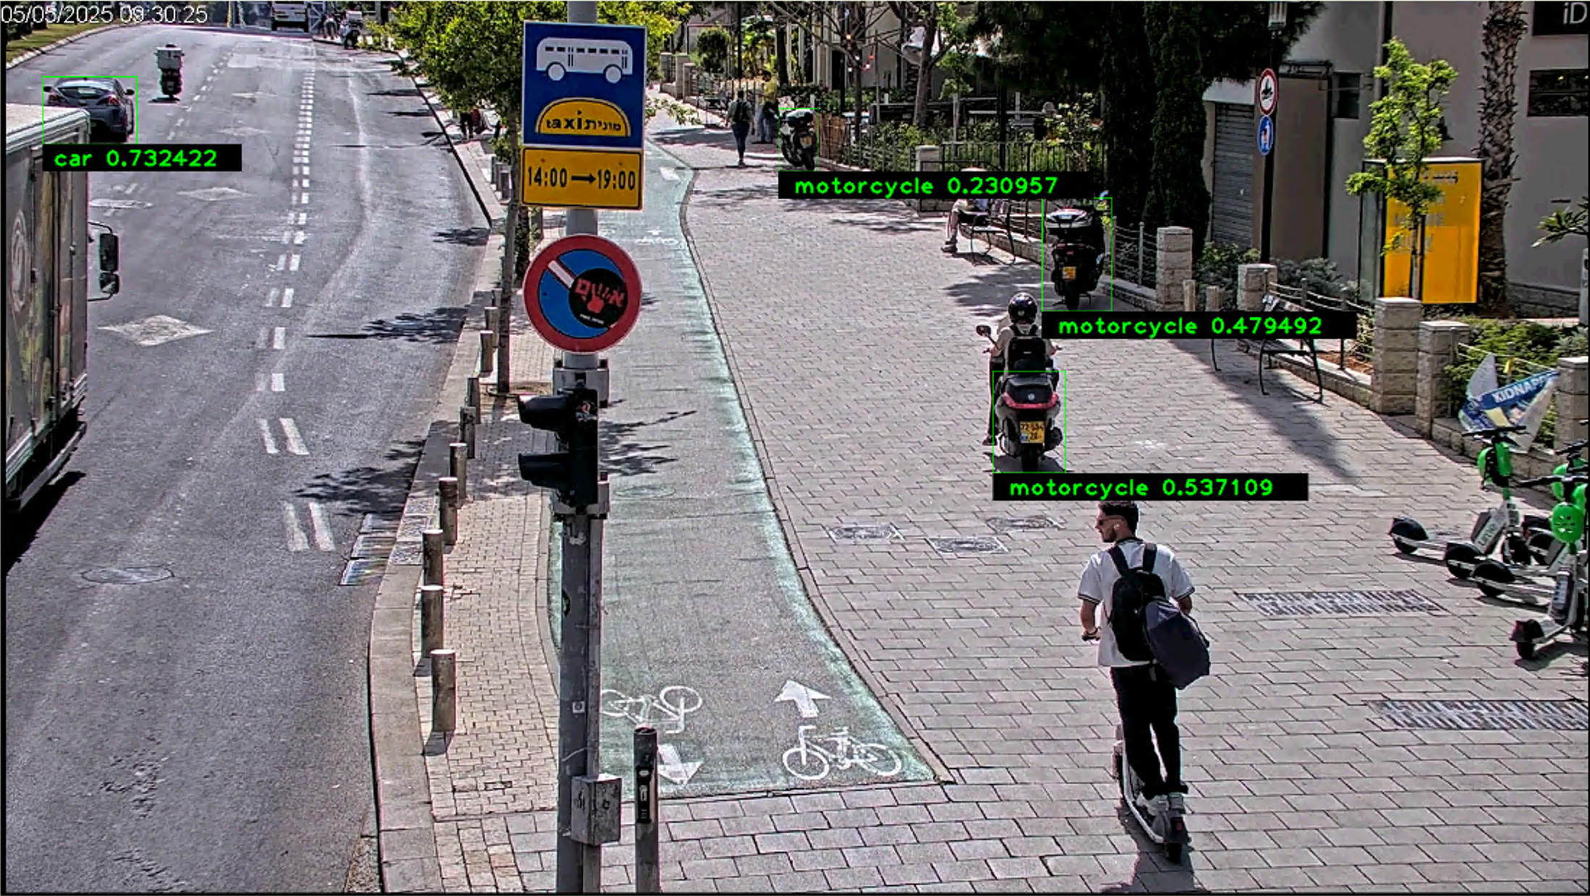
/Volumes/Model_Center/Tel-aviv/NewVideos2025/Export 05-05-2025 09-30-00/Media player format/AXIS P5655-E PTZ Dome Network Camera (10.197.21.23) - Camera 1
Scooters not detected on the right

Slide 4
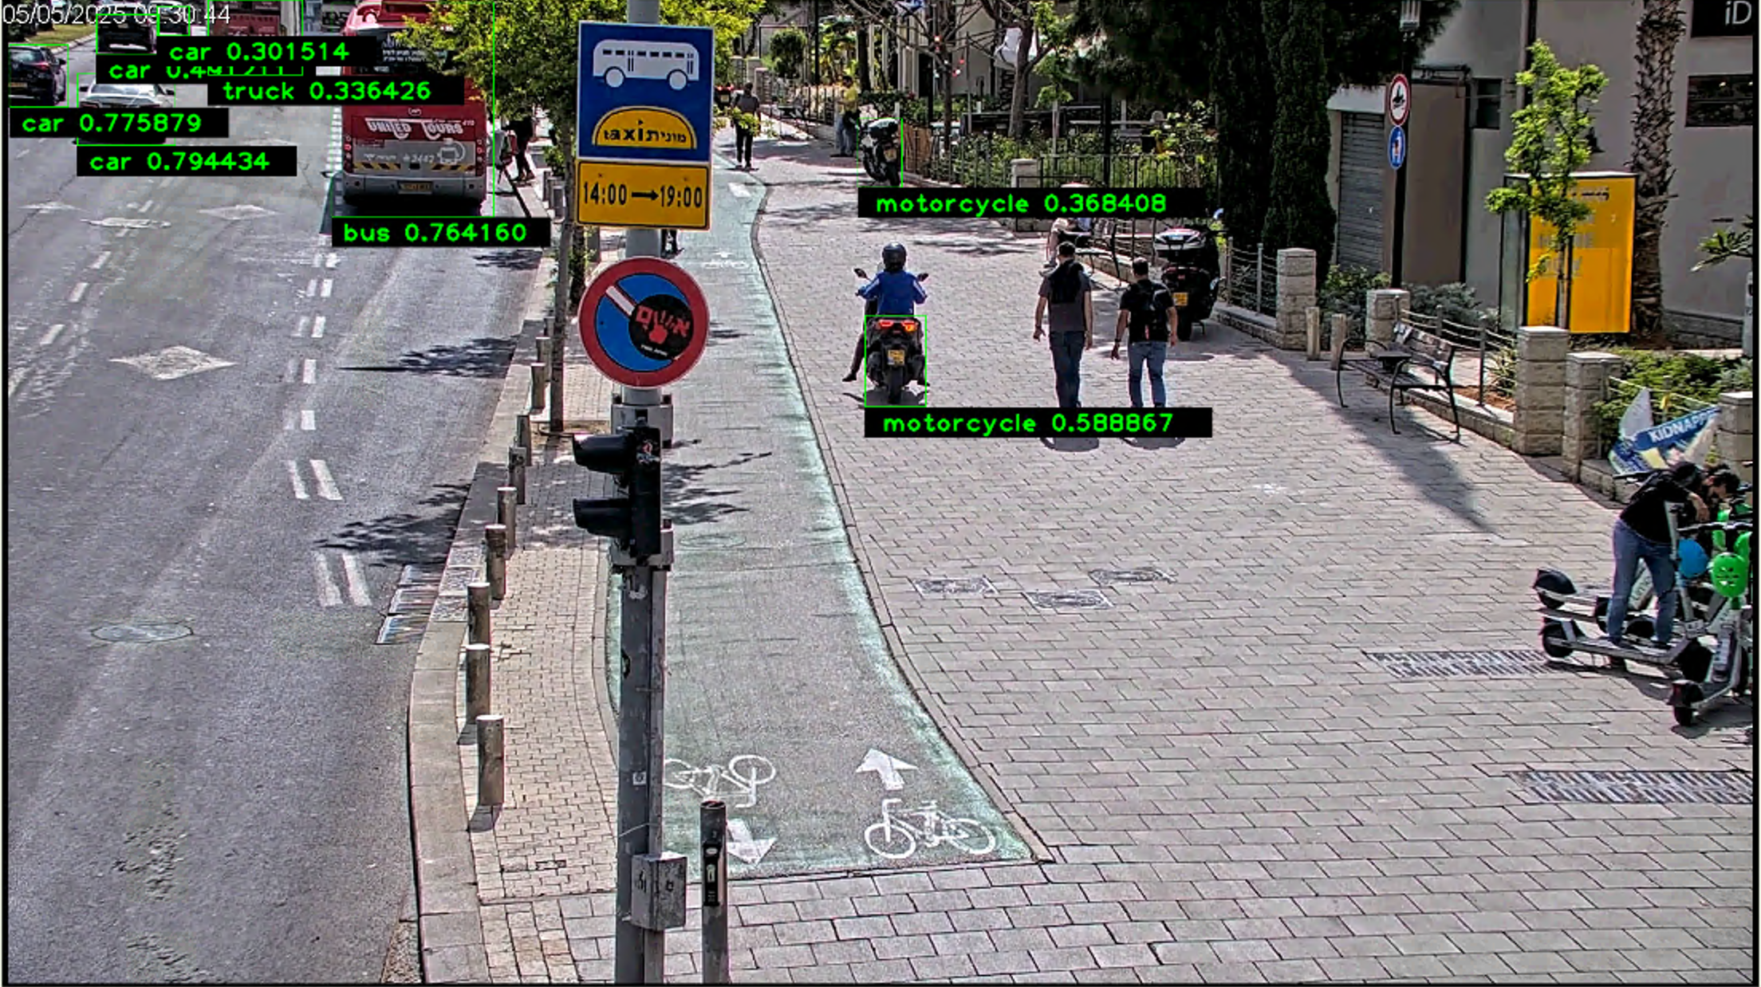
/Volumes/Model_Center/Tel-aviv/NewVideos2025/Export 05-05-2025 09-30-00/Media player format/AXIS P5655-E PTZ Dome Network Camera (10.197.21.23) - Camera 1 - Bus may be mislabelled as truck when it gets smaller

Slide 5
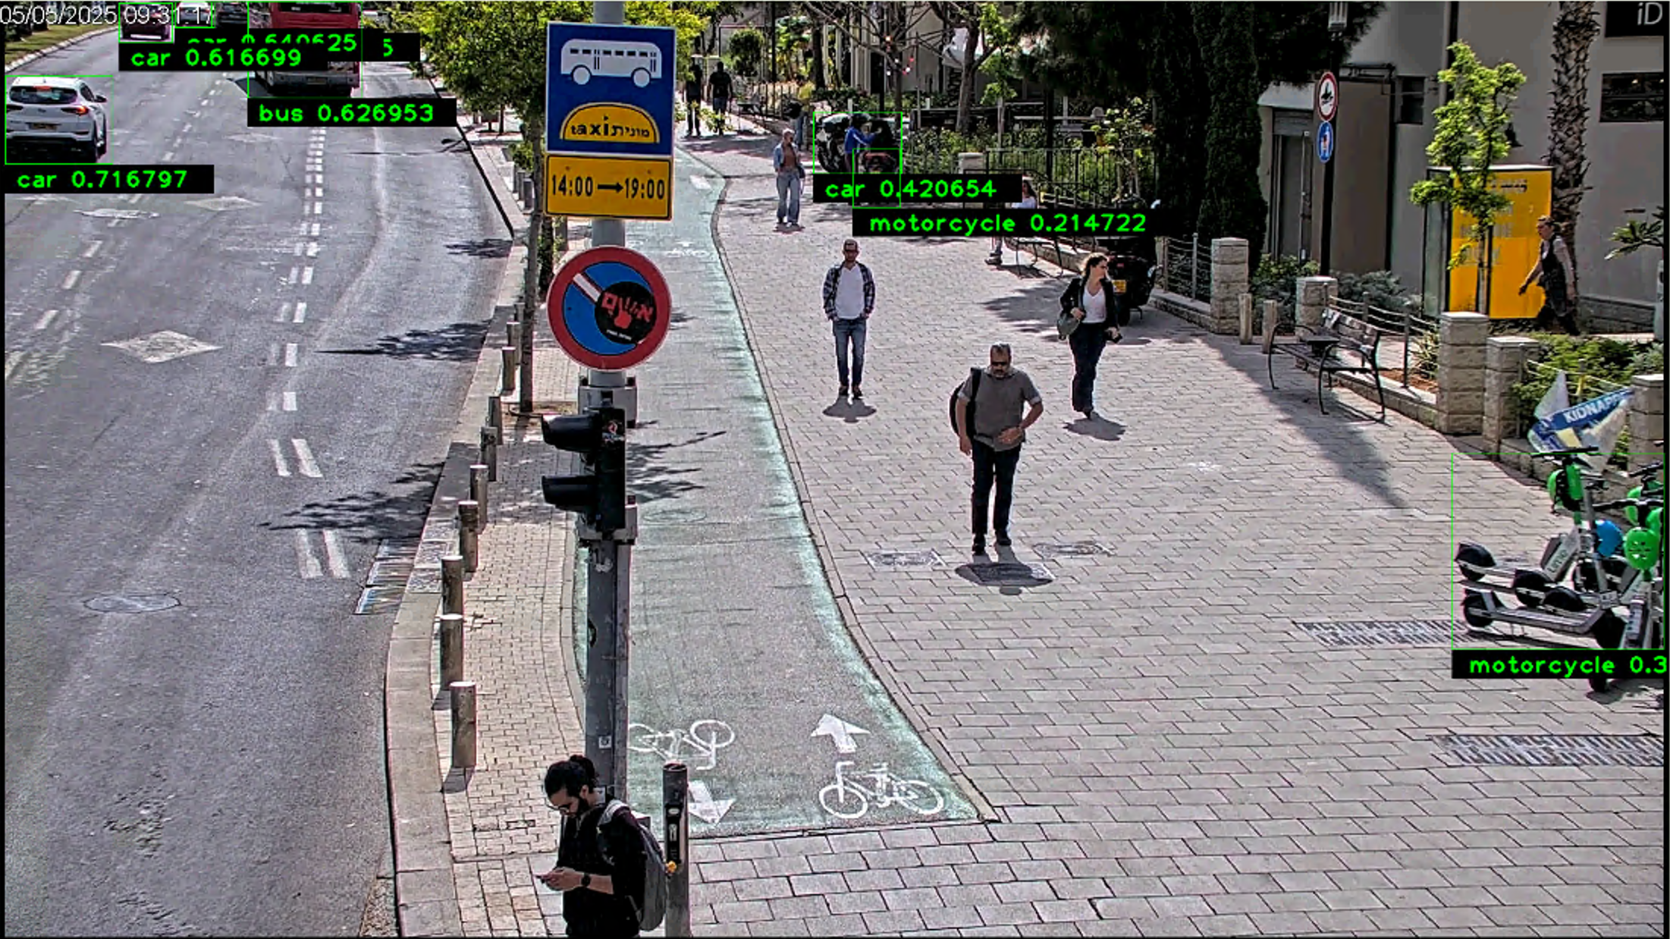
/Volumes/Model_Center/Tel-aviv/NewVideos2025/Export 05-05-2025 09-30-00/Media player format/AXIS P5655-E PTZ Dome Network Camera (10.197.21.23) - Camera 1 Incorrect labelling of car when there are 2 motorcycles close together

Slide 6
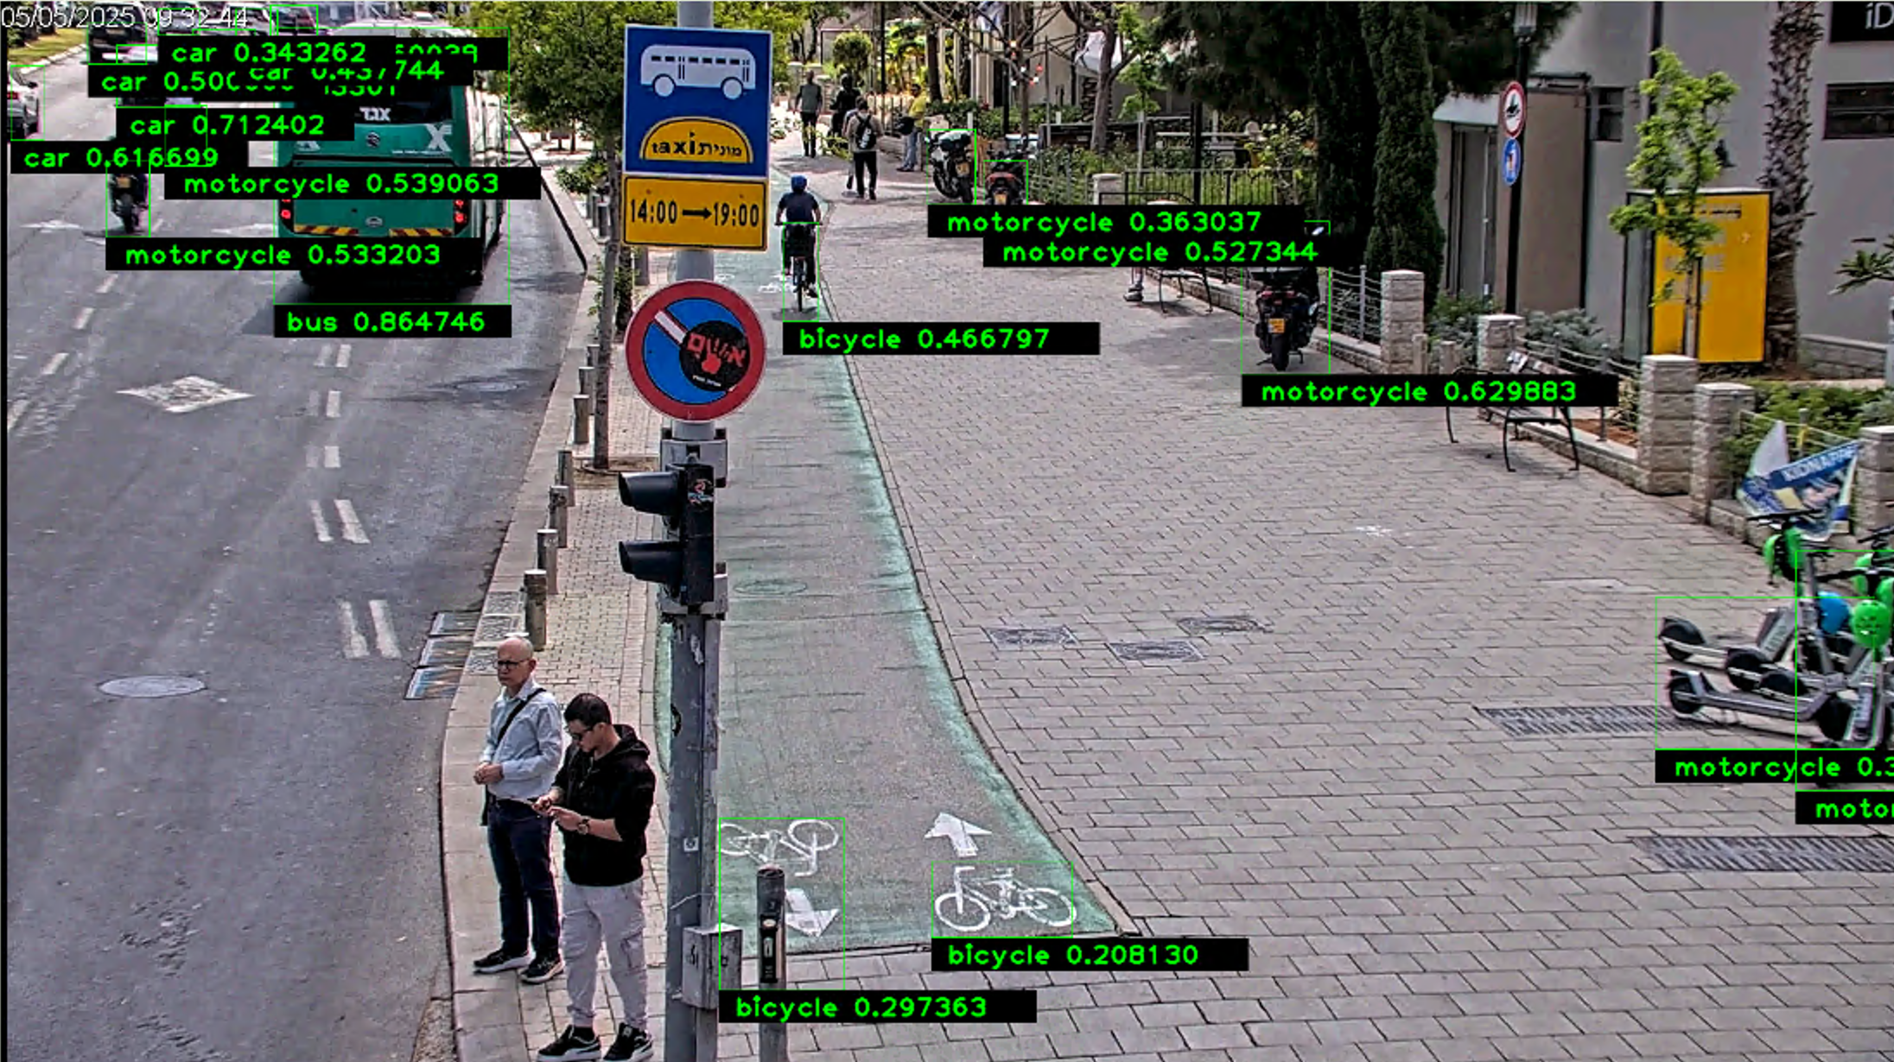
/Volumes/Model_Center/Tel-aviv/NewVideos2025/Export 05-05-2025 09-30-00/Media player format/AXIS P5655-E PTZ Dome Network Camera (10.197.21.23) - Camera 1 - False negative, detecting the floor as bicycle

Slide 7
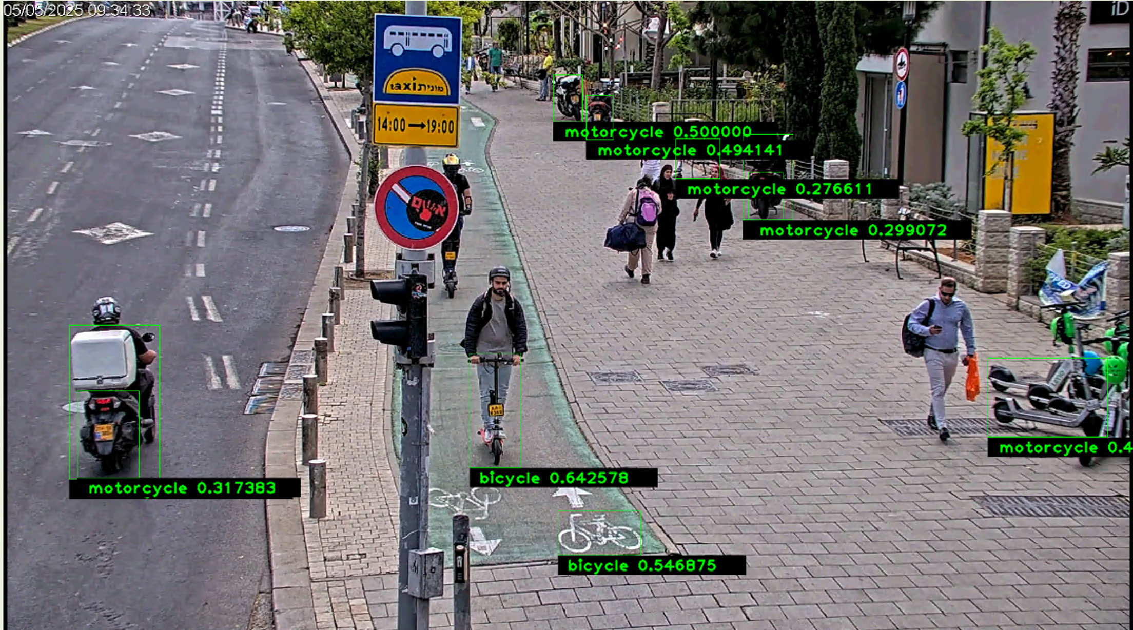
/Volumes/Model_Center/Tel-aviv/NewVideos2025/Export 05-05-2025 09-30-00/Media player format/AXIS P5655-E PTZ Dome Network Camera (10.197.21.23) - Camera 1 - Incorrect labelling of scooter as bicycle

Slide 8
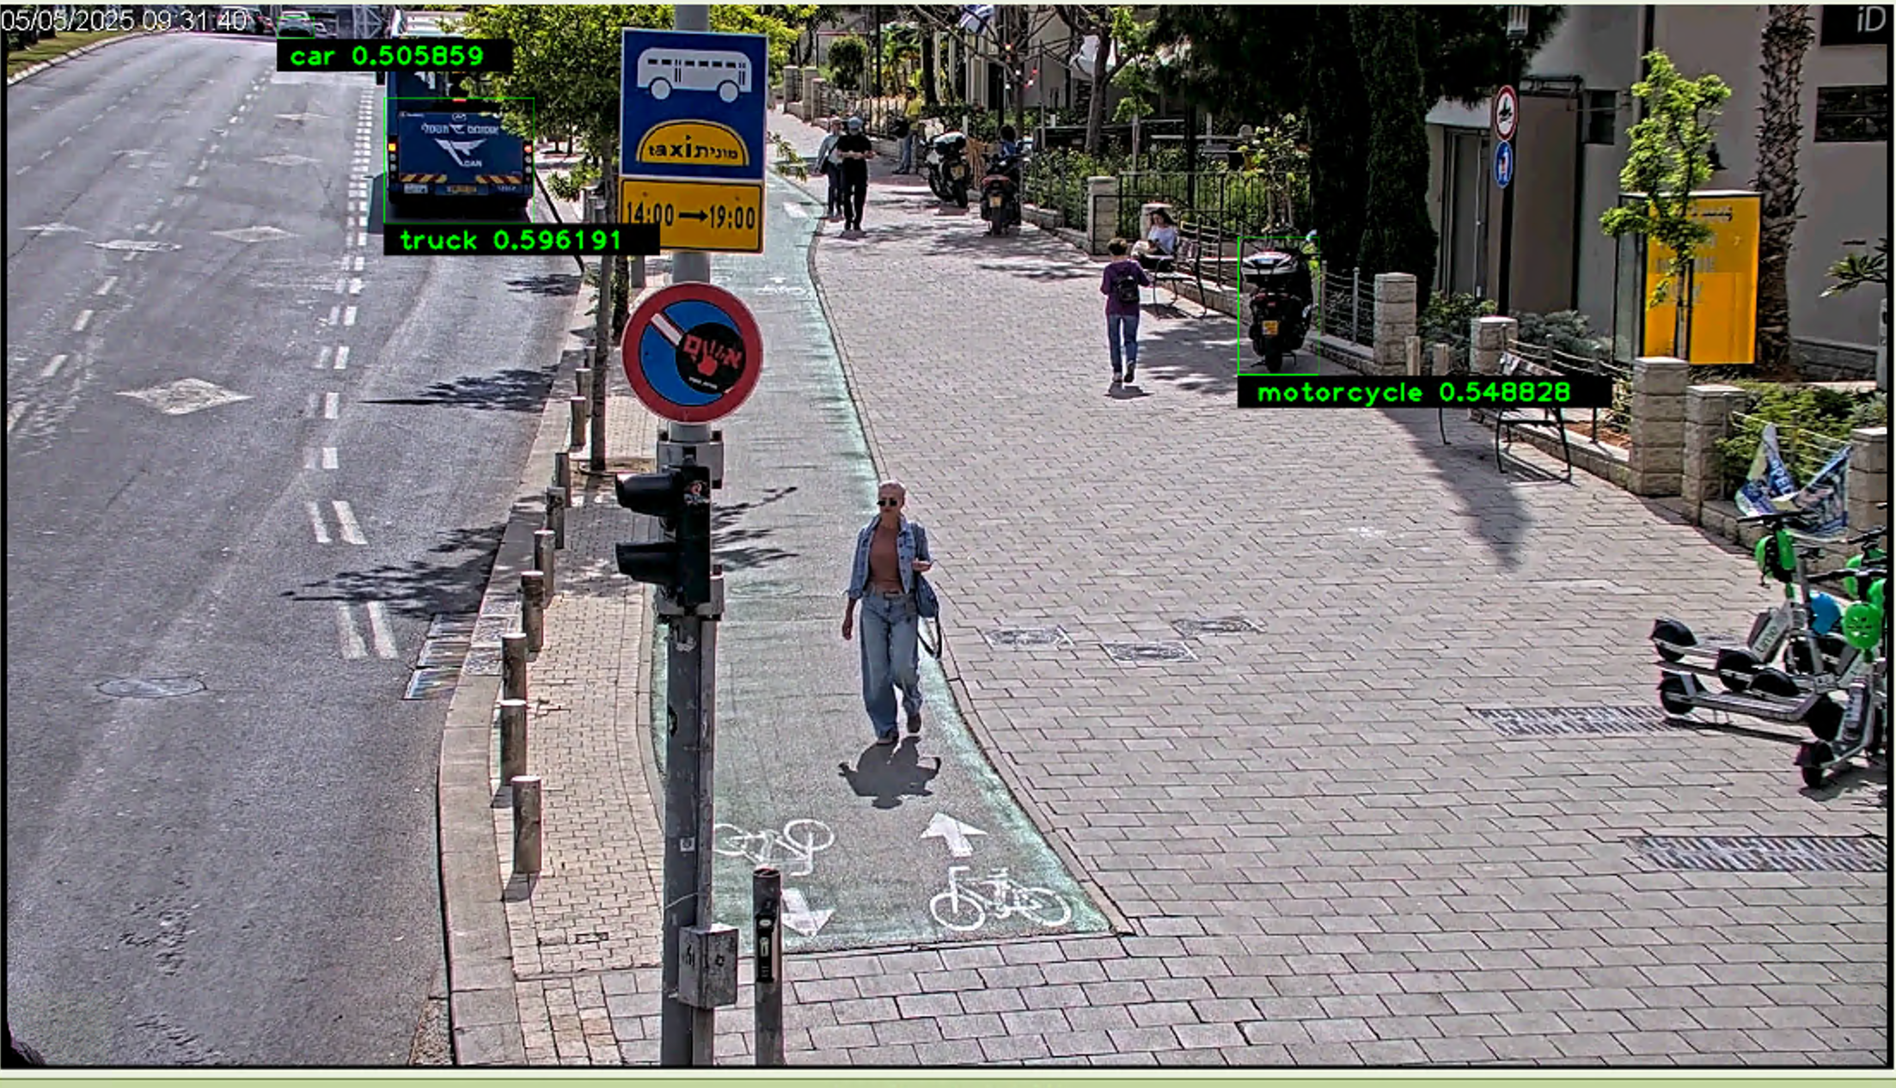
/Volumes/Model_Center/Tel-aviv/NewVideos2025/Export 05-05-2025 09-30-00/Media player format/AXIS P5655-E PTZ Dome Network Camera (10.197.21.23) - Camera 1

Slide 9
/Volumes/Model_Center/Tel-aviv/NewVideos2025/05-05-2025 09-30-00/Media player format/AXIS P5655-E PTZ Dome Network Camera (10.197.21.24) - Camera 1

Slide 10
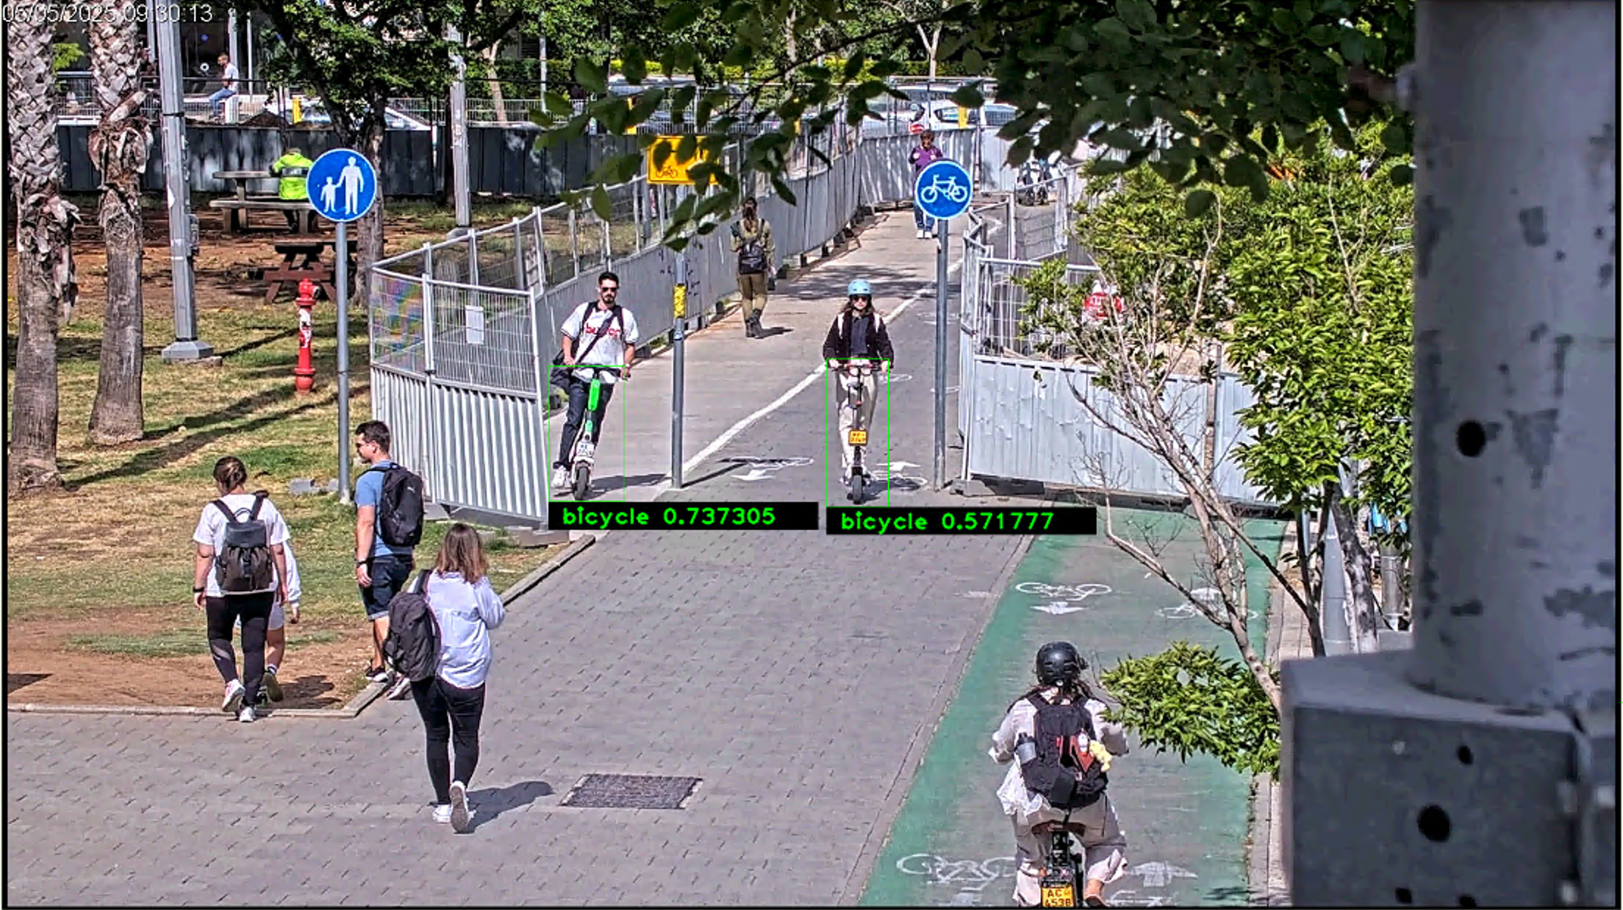
/Volumes/Model_Center/Tel-aviv/NewVideos2025/05-05-2025 09-30-00/Media player format/AXIS P5655-E PTZ Dome Network Camera (10.197.21.24) - Camera 1 - Mislabel scooter as bicycle

Slide 11
/Volumes/Model_Center/Tel-aviv/NewVideos2025/05-05-2025 09-30-00/Media player format/HikVision DS-2DE4A320IW-DE (10.197.11.21) - Camera 1

Slide 12
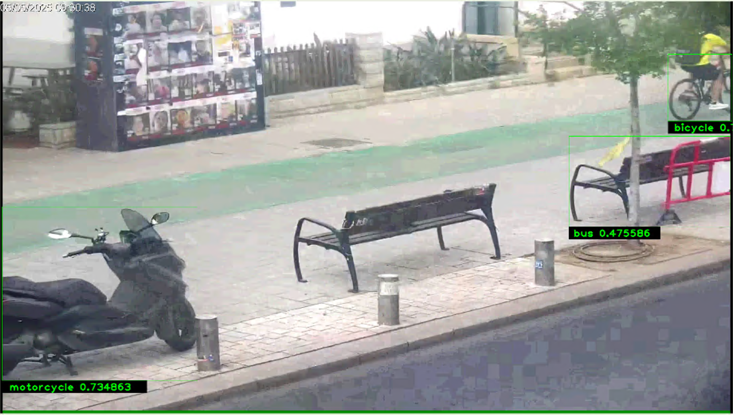
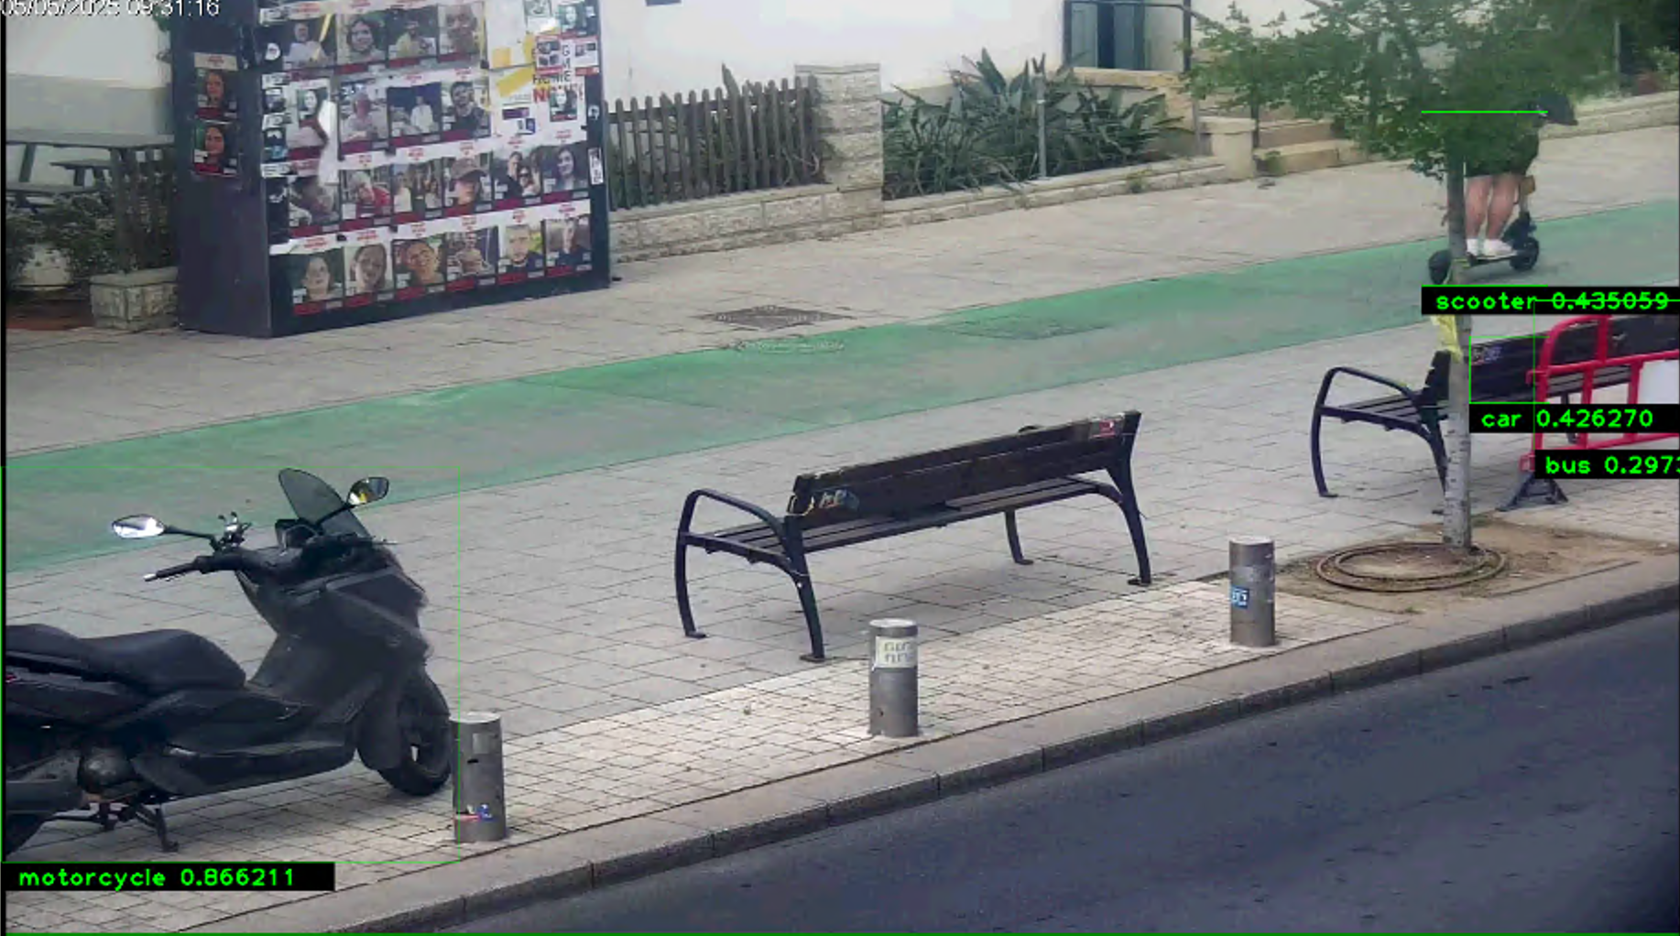
/Volumes/Model_Center/Tel-aviv/NewVideos2025/05-05-2025 09-30-00/Media player format/HikVision DS-2DE4A320IW-DE (10.197.11.21) - Camera 1 - FP bench

Slide 14
/Volumes/Model_Center/Tel-aviv/NewVideos2025/05-05-2025 09-30-00/Media player format/HikVision DS-2DE4A225IW-DE (10.197.11.22) - Camera 1

Slide 16
/Volumes/Model_Center/Tel-aviv/NewVideos2025/05-05-2025 09-30-00/Media player format/HikVision DS-2DE4A225IW-DE (10.197.11.22) - Camera 1

Slide 18
/Volumes/Model_Center/Tel-aviv/NewVideos2025/05-05-2025 09-30-00/Media player format/HikVision DS-2DE4A225IW-DE (10.197.11.22) - Camera 1

